Slide 1
MACHINE LEARNING
Humans can supply rules to logical reasoning programs
Another way is to impart the ability of constructing rules to the machines themselves. This is called Machine Learning
The machine is given raw data and it is supposed to form rules (i.e. a model or concept) about the process from which the data is generated
Two types: Symbolic data and numeric data
Symbolic machine learning
Numeric machine learning

Slide 2
IDENTIFICATION TREES
Most widely used learning method
It is a method that induces concepts from examples
The learning is supervised: i.e. the classes or categories of the data instances are known
It represents concepts as decision trees, a representation that allows us to determine the classification of an object by testing its values for certain properties

Slide 3
IDENTIFICATION TREES
We may think of each property of an instance as contributing a certain amount of information to its classification.
For example, if our goal is to determine the species of an animal, the discovery that it lays eggs contributes a certain amount of information to that goal

Slide 4
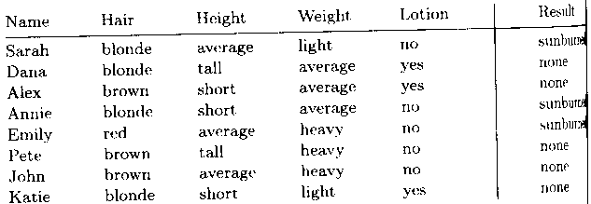
IDENTIFICATION TREES
From Data to Identification Trees
Step 1: Collect data

Slide 5
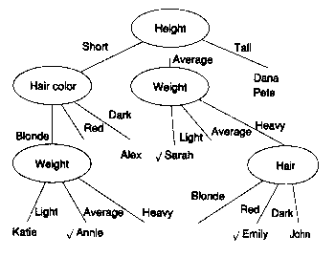
IDENTIFICATION TREES
From Data to Identification Trees
Step 2: Make identification tree

Slide 6
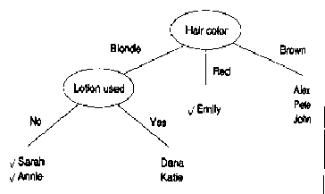
IDENTIFICATION TREES
From Data to Identification Trees
Step 2: Make identification tree

Slide 7
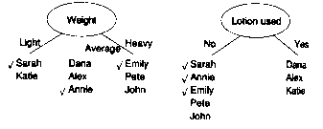
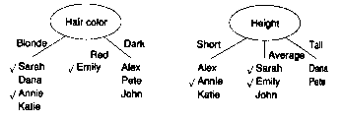
IDENTIFICATION TREES
From Data to Identification Trees
Step 2: Make identification tree
(select tests which minimize disorder)

Slide 8
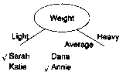
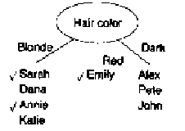
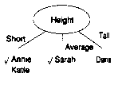
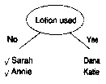
IDENTIFICATION TREES
From Data to Identification Trees
Step 2: Make identification tree
(select tests which minimize disorder)

Slide 9

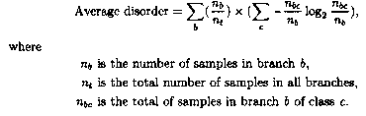
IDENTIFICATION TREES
From Data to Identification Trees
Step 2: Make identification tree
(select tests which minimize disorder)

Slide 10
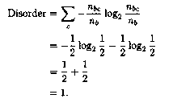
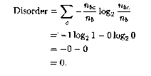
IDENTIFICATION TREES
From Data to Identification Trees
Step 2: Make identification tree
(select tests which minimize disorder)

Slide 11
IDENTIFICATION TREES
From Data to Identification Trees
Step 2: Make identification tree
(select tests which minimize disorder)
The formula can be converted from log₂ to log₁₀
log_{x}(M) = log₁₀M . log_{x}10
= log₁₀M/log₁₀x
Hence log₂(Y) = log₁₀(Y)/log₁₀(2)

Slide 12
IDENTIFICATION TREES
From Data to Identification Trees
Step 2: Make identification tree
(select tests which minimize disorder)
For our example, the disorders of tests at the first and second levels are:
Test Disorder Test Disorder
Hair 0.5
Height 0.69 Height 0.5
Weight 0.94 Weight 1.0
Lotion 0.61 Lotion 0

Slide 13
IDENTIFICATION TREES
From Identification Trees to Rules
Step 3: Make rules from the identification tree
After making the identification tree, we trace each path from the root node to leaf node,
recording the test outcomes as antecedents
and
the leaf node classification as the consequent

Slide 14
IDENTIFICATION TREES
From Identification Trees to Rules
Step 3: Make rules from the identification tree
For our example we have:
If the person’s hair is blonde
and the person uses lotion
then the person is not sunburned
If the person’s hair is blonde
and the person uses no lotion
then the person is sunburned

Slide 15
IDENTIFICATION TREES
From Identification Trees to Rules
Step 3: Make rules from the identification tree
For our example we have:
If the person’s hair is red
then the person is sunburned
If the person’s hair is brown
then the person is not sunburned

